Slide 1
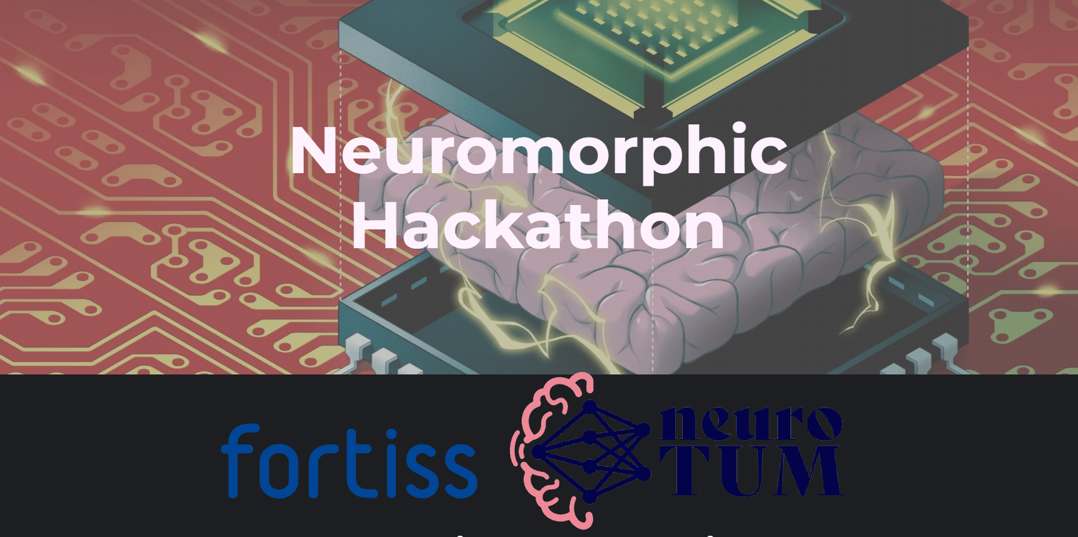

Slide 2

Temporal feature learning with resonate&fire SNN
Thomas Huber, Eric Armbruster, Borislav Polovnikov
Managers: Jules Lecomte,
Reem Al-fata

Slide 3
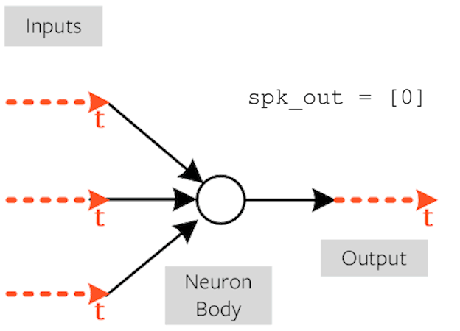
Goal: Detect patterns in temporal data
Modern communication
= streams of 0s & 1s
SNNs can be used to efficiently learn and efficiently process temporal data
e.g. detect patterns in noisy data
channels

Slide 4
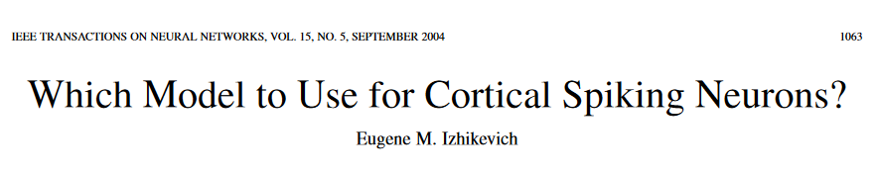
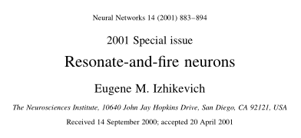
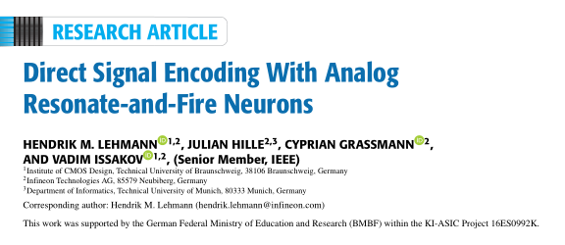
Literature review

Slide 5
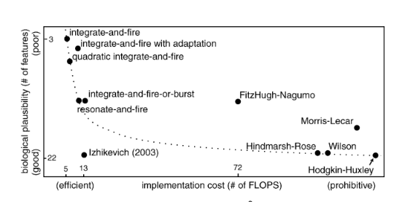
Theoretical approach: RF neurons
Artificial neuron model balancing biological plausibility and cost of computation

Slide 6
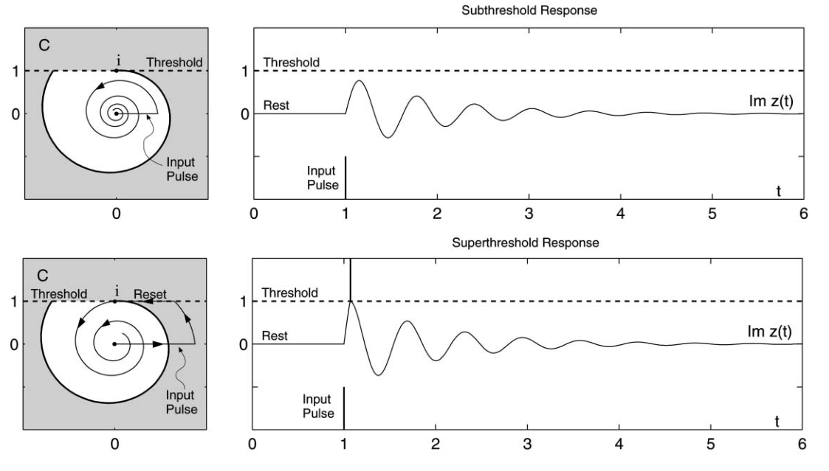

Slide 7
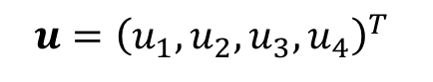
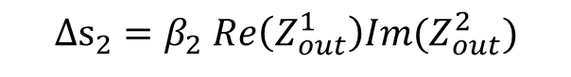
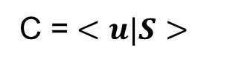
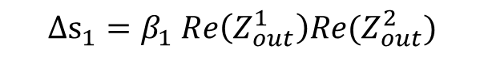
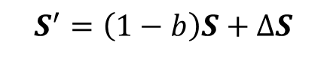
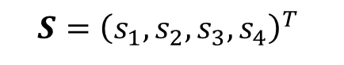
Unsupervised Hebbian learning algorithm
Z_{out}
Z_{in}
Z_{in} = C*Z_{out}
C = $<u|S>$
RF₁
RF₂
$$u={\left(u_{1}, u_{2},u_{3},u_{4}\right)}^{T}$$
Neuron hyperparameters
$$S={\left(s_{1}, s_{2},s_{3},s_{4}\right)}^{T}$$
Connection weights
$${Δs}_{1}=β_{1} Re\left(Z_{out}^{1}\right)Re(Z_{out}^{2})$$
$$S^{′}=\left(1−b\right)S+ΔS$$
$${Δs}_{2}=β_{2} Re\left(Z_{out}^{1}\right)Im(Z_{out}^{2})$$
…

Slide 8
Tools
Custom network architecture on top of the lava-implemented RF neuron
Custom visualization tools to accelerate data interpretation and parameter tuning

Slide 9
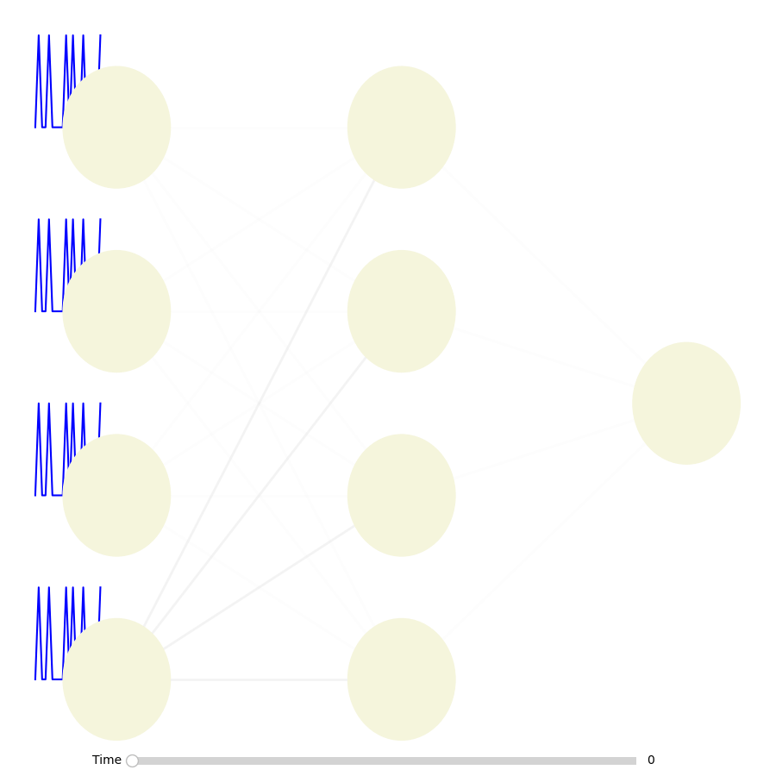
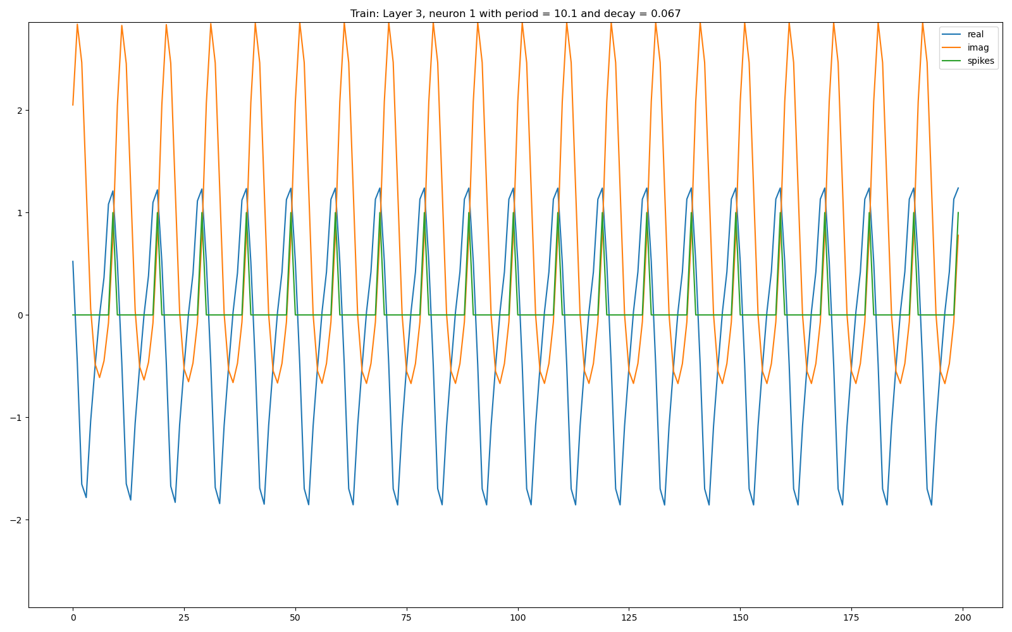
Results: train simple network to complex periodic signal over 1000 iterations

Slide 10
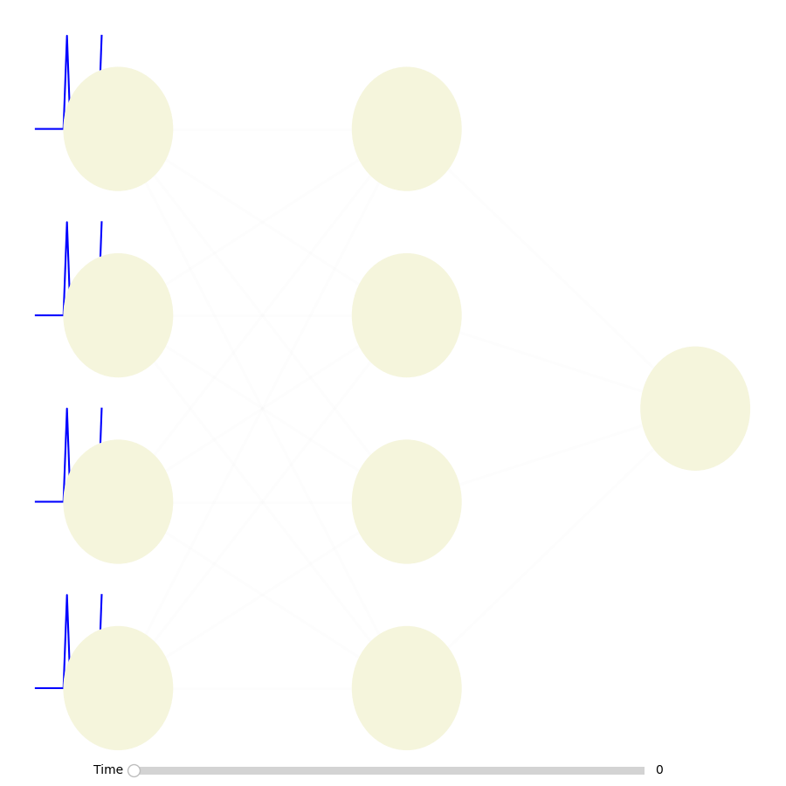
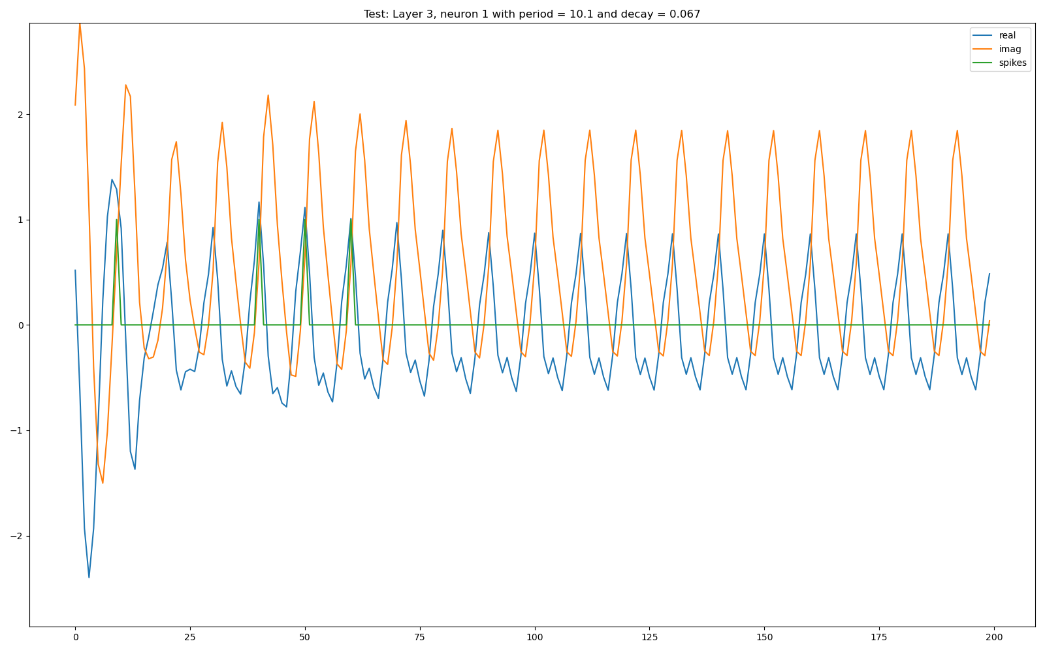
Results: test the trained network on a different input

Slide 11
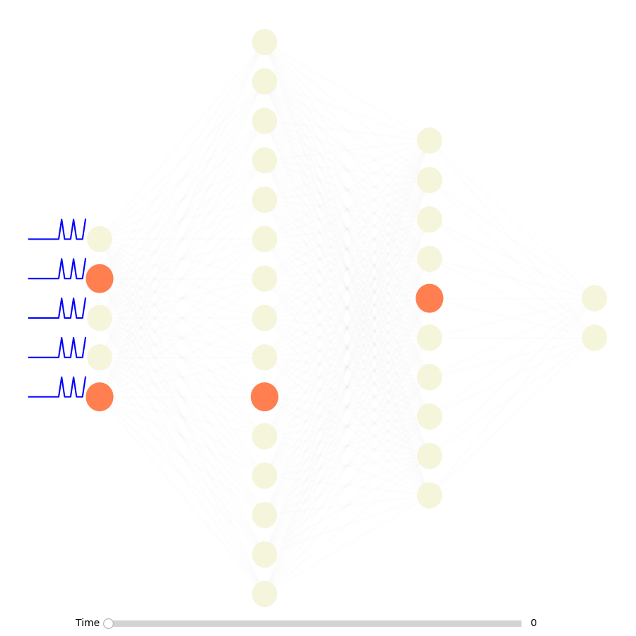
Application and demo
Large networks for automatic Morse-code detection, e.g. for SOS calls
Trained model, train data

Slide 12
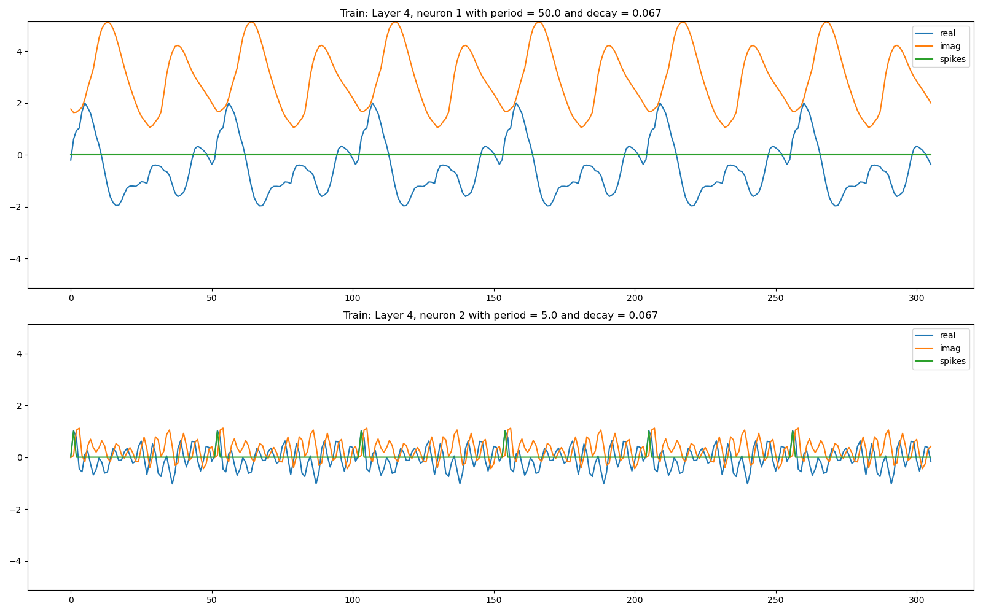

Slide 13
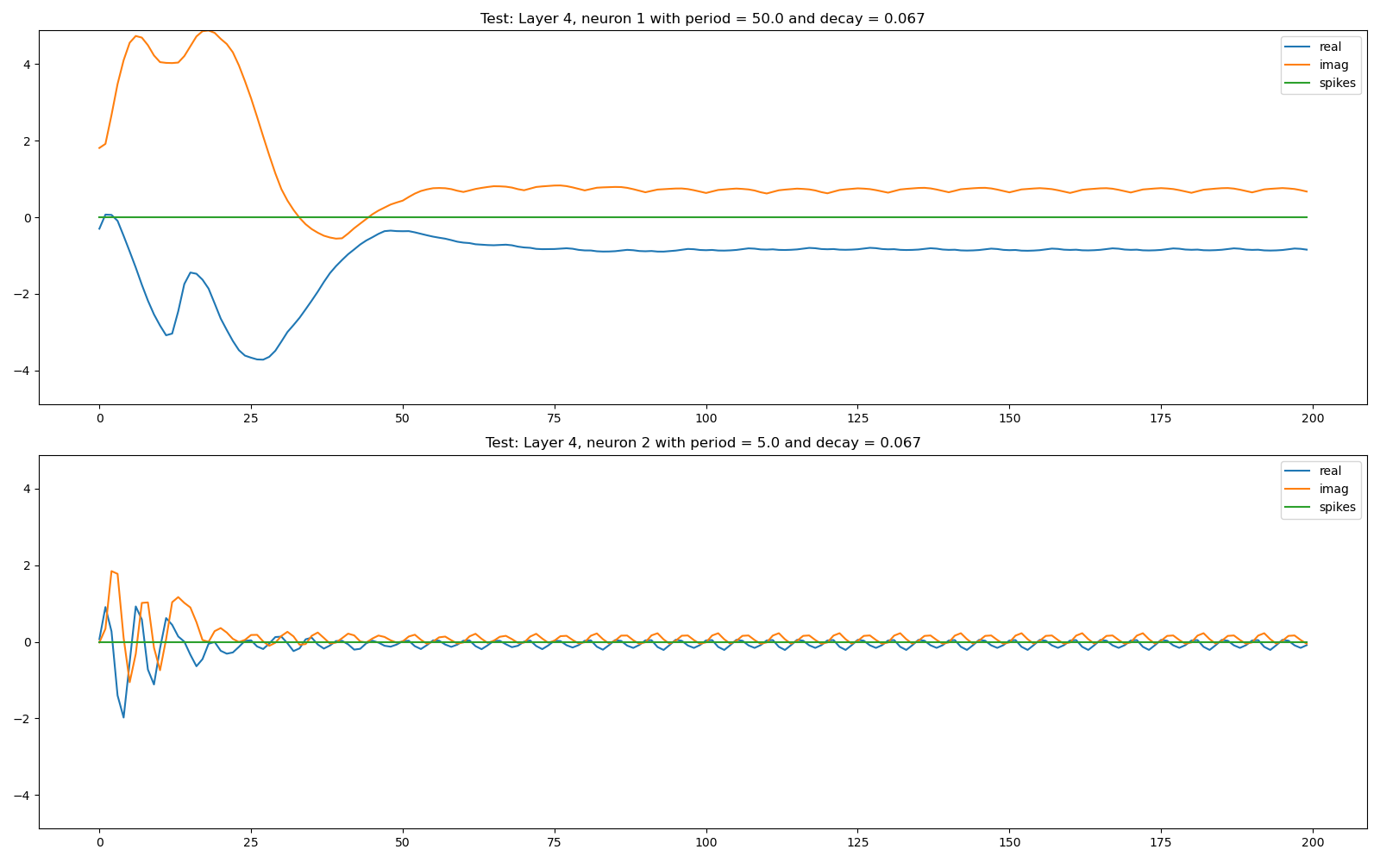

Slide 14
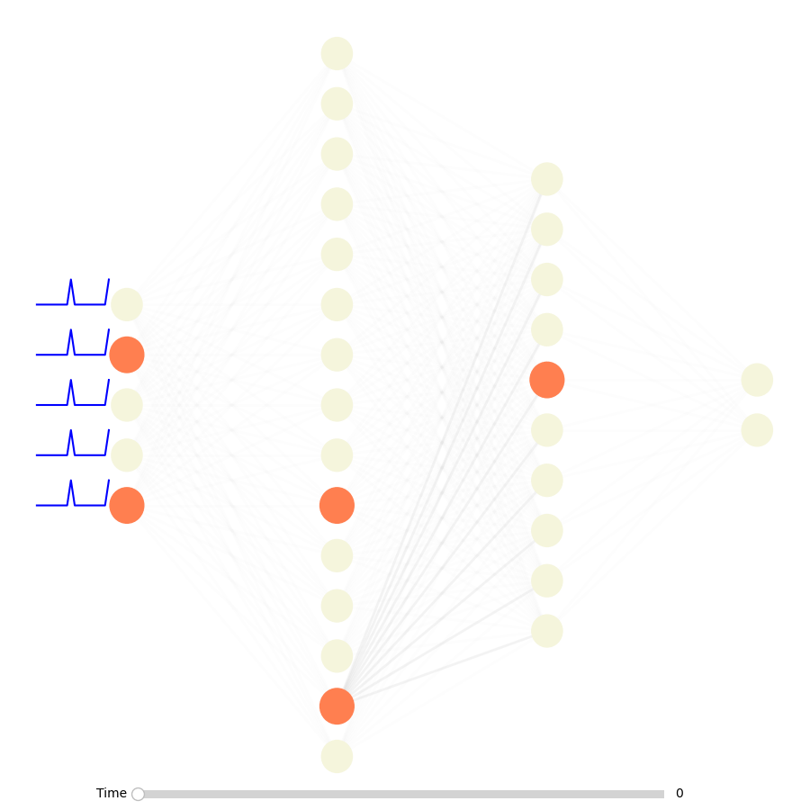
Application and demo
Large networks for automatic Morse-code detection, e.g. for SOS calls
Test data

Slide 15
Outlook
Build and train large networks with different parameters to detect more complex patterns
Investigate different connections like convolutional layers or mix LIF and RF neurons together

Slide 16
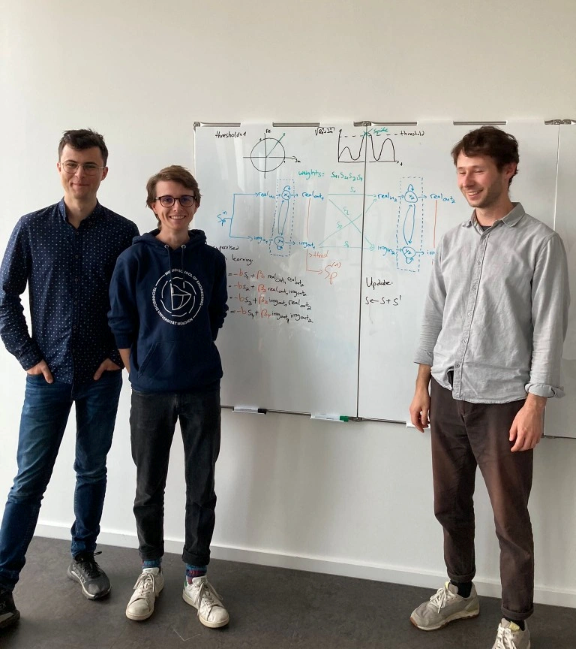

Hebbian ♥ RF
Thank you

